Slide 1
| Focus | Quality |Honesty |
PVT SYSTEM
Jiaxing Yunyu New Energy Co.,Ltd
Science and technology is the first productive force,
the people are the first resource

Slide 2
Contents
01
02
03
04
05
About Us
PVT Technology
PVT
Applications
Four in One – PVT Distributed Energy Network
Energy Saving

Slide 3
About Us
Company Profile
01
——CONTENTS——

Slide 4
About Us
Jiaxing Yunyu New Energy Co.,Ltd
Committed to solar thermal research for more than 16 years, photovoltaic system research for more than 6 years, and system research for more than 4 years, Jiaxing Yunyu has acquired over 10 domestic invention patents on integrated photovoltaic thermal systems. Our solar energy focuses on large-scale production and design, research and installation of the whole photovoltaic thermal system, contributing a lot to the national carbon neutrality as well as peak carbon dioxide emissions.

Slide 5
PVT Technology
Photovoltaic/ thermal solar system
02
——CONTENTS——

Slide 6
PVT Technology
PVT technology is a kind of technology integrating photovoltaic, photothermal and thermal energy. With traditional photovoltaic panels, 100% solar energy hits the photovoltaic panels. The photovoltaic panels only convert about 17-23% of the energy into electrical energy, and the remaining 5% is reflected off and then is wasted into the air. However, our PVT technology maximizes the absorption of waste heat from this part of photovoltaic panels, which is stored in the water tank through the circulation pump, and uses the heat pump, water source heat pump and other technologies to further maintain constant temperature, so as to meet the requirements of hot water supply and heating. Our PVT technology achieves much higher overall efficiency and much better utilization of the solar spectrum.
While absorbing the waste heat of photovoltaic panels, PVT panels also play a role of cooling down, so as to increase the power generation on the panels. The annual power generation can be improved by 11%, and even up to 21% in summer.

Slide 7
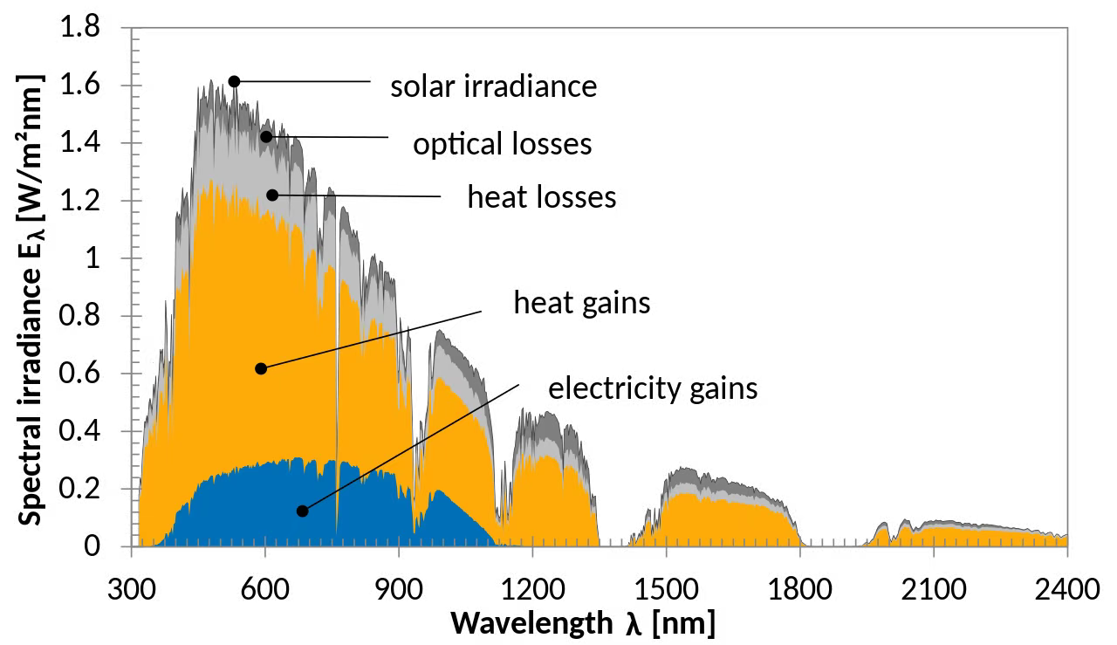
PVT Technology
The solar energy can only be converted to electricity when the solar photovoltaic panels are at the appropriate temperature. Our PVT panels reduces the surface temperature of the photovoltaic panels and improve the power generation efficiency.

Slide 8
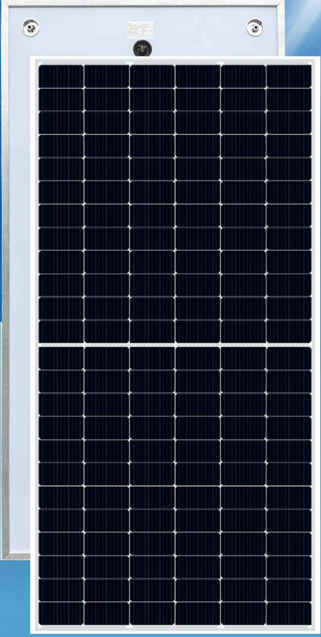
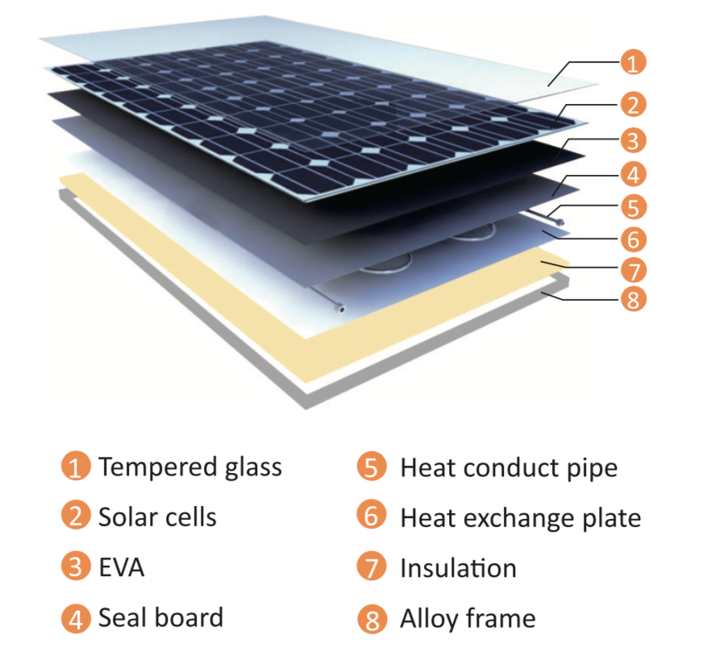
PVT Technology
Schematic Diagram of Our PVT Panels

Slide 9
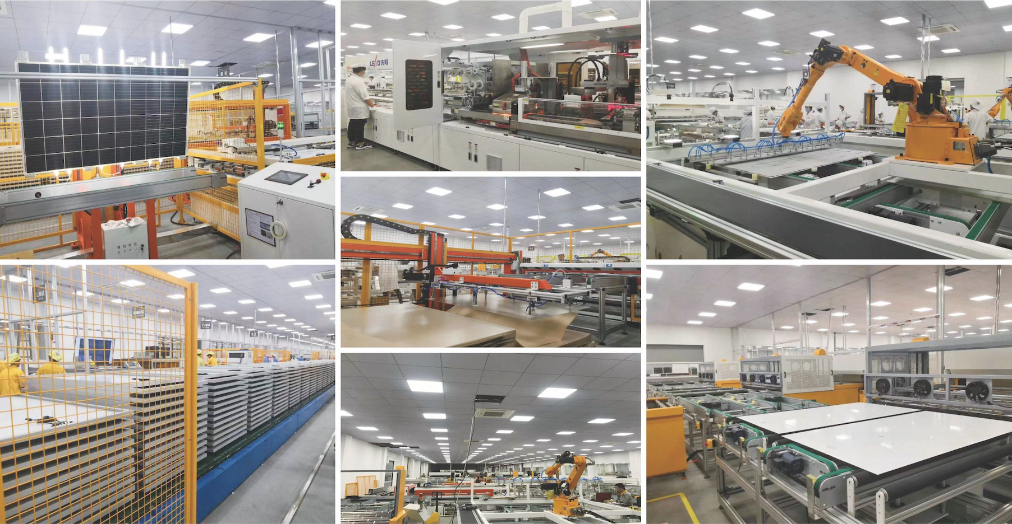
PVT Technology

Slide 10
PVT Applications
Scope of application
03
——CONTENTS——

Slide 11
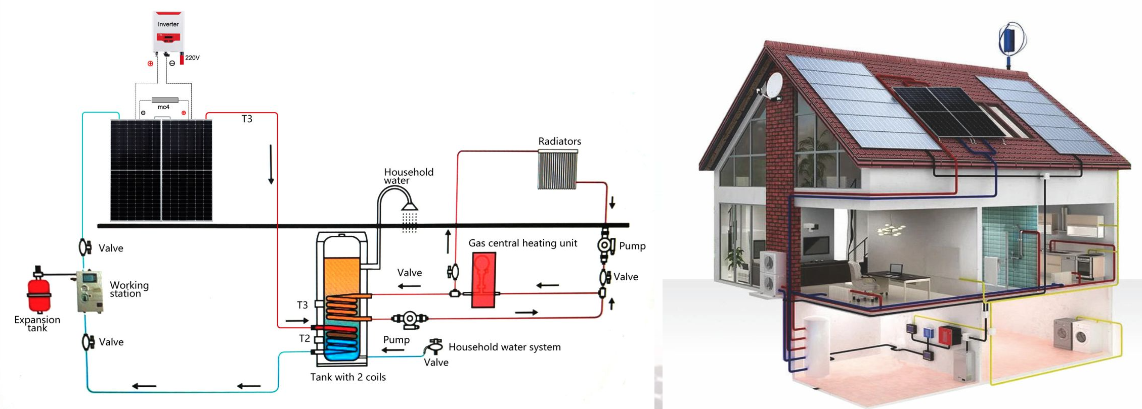
PVT Applications
01 Hot Water Supply and Heating for Residence
02 Swimming Pool Heating
03 Hot Water Supply and Heating for School
04 Heating for Greenhouse and Farm

Slide 12
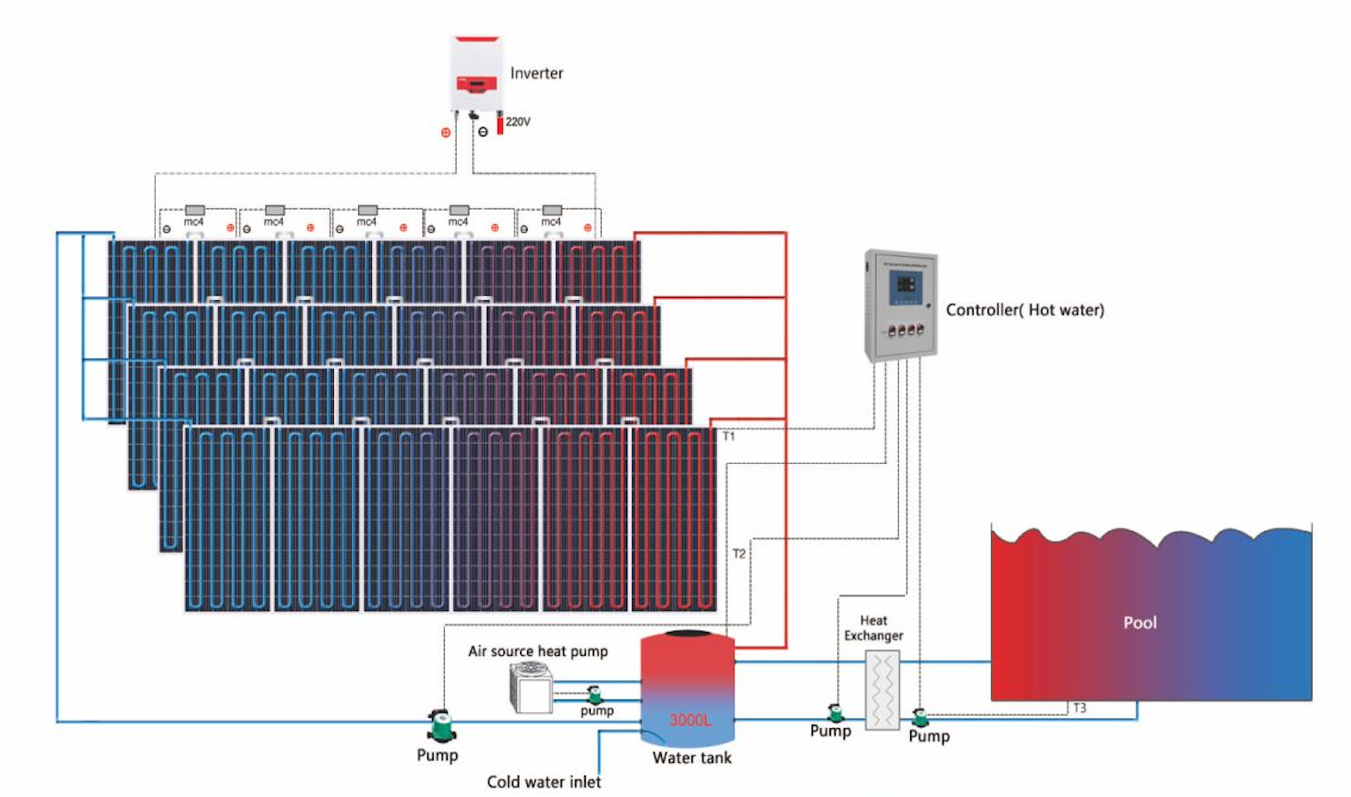
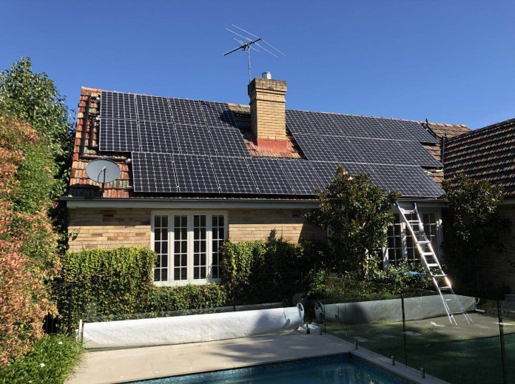
PVT Applications
01 Hot Water Supply and Heating for Residence
02 Swimming Pool Heating
03 Hot Water Supply and Heating for School
04 Heating for Greenhouse and Farm

Slide 13
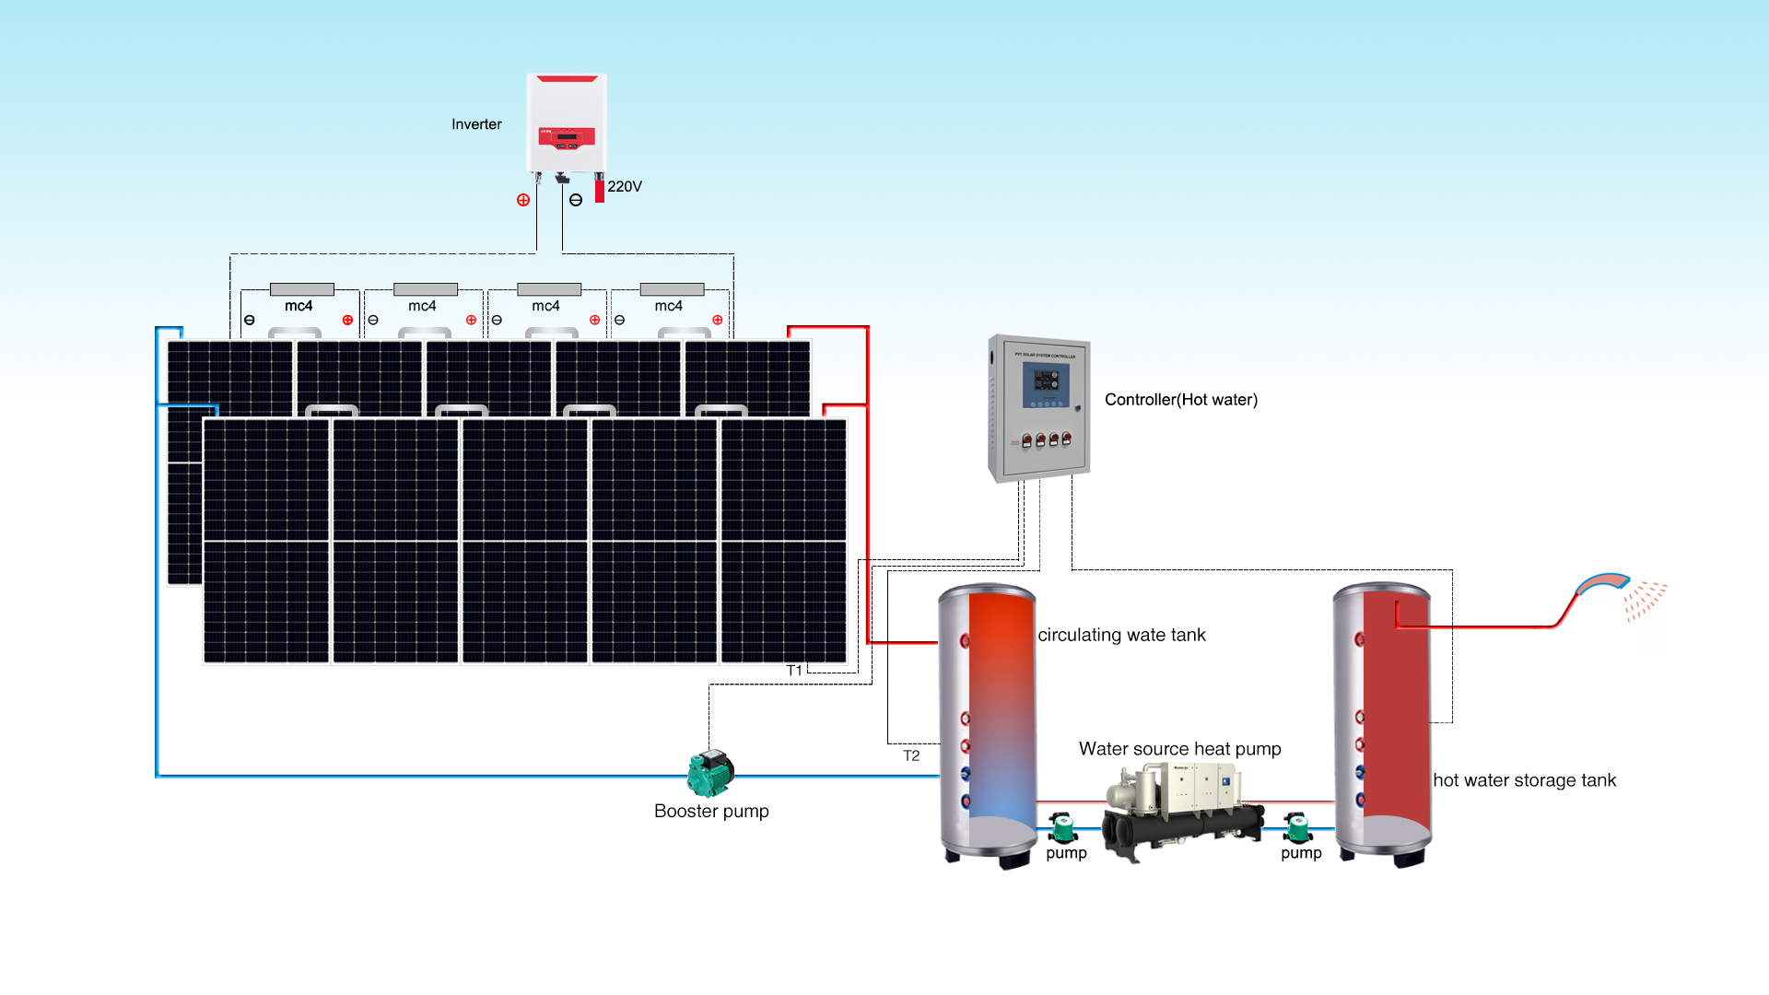
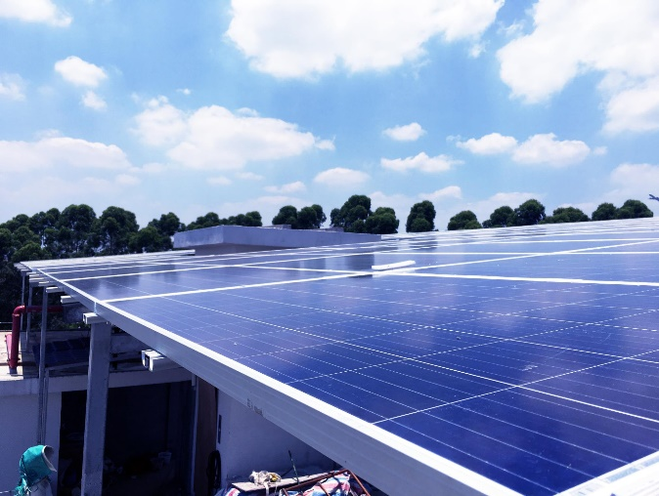
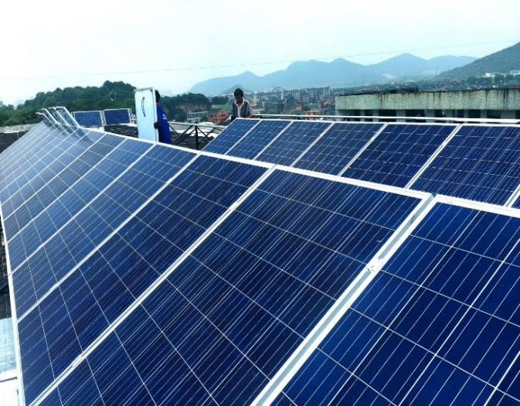
PVT Applications
01 Hot Water Supply and Heating for Residence
03 Hot Water Supply and Heating for School
02 Swimming Pool Heating
04 Heating for Greenhouse and Farm

Slide 14
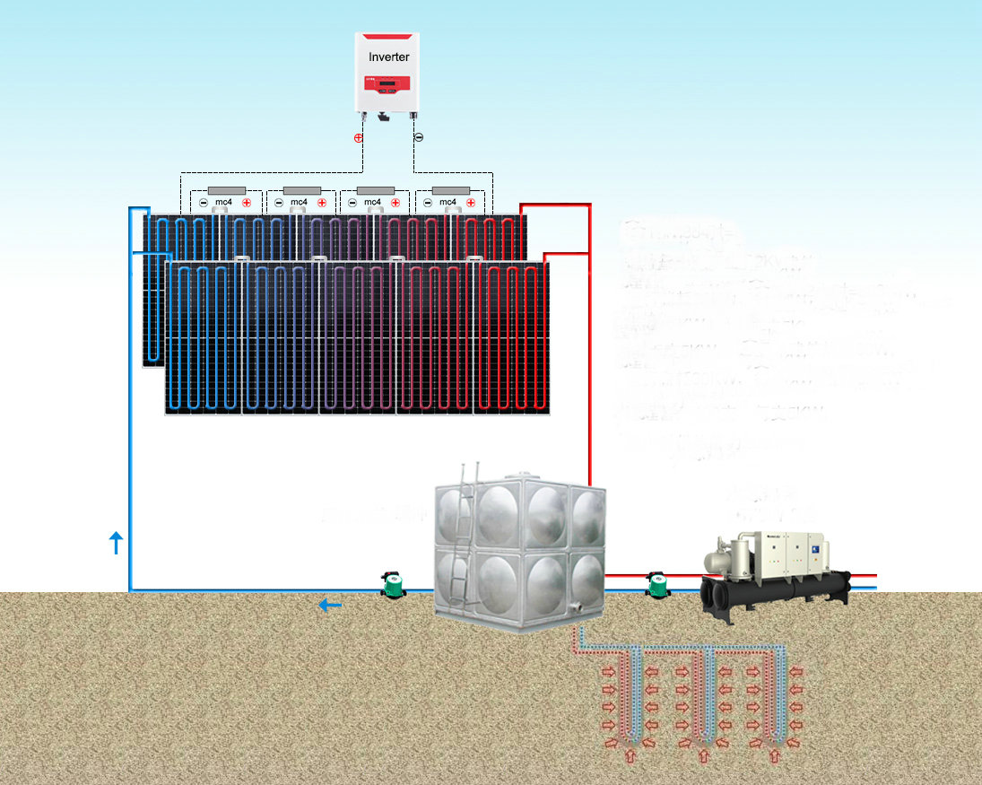
PVT Applications
01 Hot Water Supply and Heating for Residence
03 Hot Water Supply and Heating for School
04 Heating for Greenhouse and Farm
02 Swimming Pool Heating

Slide 15
Four in One -PVT Distributed Energy Network
Four in one regional network
04
——CONTENTS——

Slide 16
Four in One – PVT Distributed Energy Network
Using PVT, heat pump, and seasonal energy storage, the original integration of multiple technologies provides a four-in-one service combining power generation, heating, cooling, and hot water supply. Additionally, it also provides a full service including products, design, installation and after-sales services.
Notes:
太阳能 Solar Energy
集热 Thermal Collection
太阳能集热器 Solar Thermal Collector
水箱 water tank
太阳能供热 Solar Heating
建筑 Buildings
地热能 Geothermal Energy
地埋管换热器 BHE (Ground Heat Exchanger)
土壤取热 Soil Heat Extraction
热泵机组 Heat Pump Units
电能 Electrical Energy
热泵供热 Heating via Heat Pump

Slide 17
Energy Saving
Energy saving
05
——CONTENTS——

Slide 18
Energy Saving
Why Focus Heating?
In areas where heating is necessary, such as residential homes in northern China, 80% of energy is used for heating in the cold environment, 17% for hot water, 14% for electrical appliances, 4% for lighting, and only 1% for refrigeration. Heating accounts for the majority of household energy consumption. PVT solves most of the heating and power needs, achieving true zero-carbon for buildings.

Slide 19
Why Focus Seasonal Storage？

Slide 20
Thank You!
Science and technology is the first productive force,
the people are the first resource
PPT模板下载：www.1ppt.com/moban/ 行业PPT模板：www.1ppt.com/hangye/
节日PPT模板：www.1ppt.com/jieri/ PPT素材下载：www.1ppt.com/sucai/
PPT背景图片：www.1ppt.com/beijing/ PPT图表下载：www.1ppt.com/tubiao/
优秀PPT下载：www.1ppt.com/xiazai/ PPT教程： www.1ppt.com/powerpoint/
Word教程： www.1ppt.com/word/ Excel教程：www.1ppt.com/excel/
资料下载：www.1ppt.com/ziliao/ PPT课件下载：www.1ppt.com/kejian/
范文下载：www.1ppt.com/fanwen/ 试卷下载：www.1ppt.com/shiti/
教案下载：www.1ppt.com/jiaoan/
字体下载：www.1ppt.com/ziti/

